Slide 1
TEACHER ONLY — hidden in slideshow
Y9 · Ecosystems L1 of 3 · 50 minutes
What is an ecosystem? Living, non-living, and the gold forest at Prasae
PRIOR KNOWLEDGE
MISCONCEPTIONS (wrong → right)
LESSON FLOW (50 min)
• Photosynthesis: light + CO₂ + water → glucose (Y7 Cells, Y8 Plants).
• Characteristics of living things (Y7 U2).
• Species and classification (Y8 invertebrates / vertebrates).
• Habitat and adaptation (Y8 Behaviour of Animals).
• Just finished: Weather & Climate — they can already measure temperature, rainfall and humidity. Use that. Abiotic factors are simply "the weather-type things, plus salt, mud and nutrients".
EAL note: ecosystem / habitat / community are near-synonyms in everyday English. Draw the boundary explicitly on slide 8.
✗ "An ecosystem is the plants and animals in a place."
→ It is the community PLUS the non-living surroundings. Take away the salt water and there is no mangrove.
✗ "Abiotic means dead."
→ Abiotic means never alive. A dead mangrove leaf is BIOTIC.
✗ "Habitat and ecosystem are the same."
→ Habitat = where one species lives. Ecosystem = all species + surroundings.
✗ "Decomposers are dirty and unimportant."
→ They release the nutrients everything else needs.
✗ "Big animals matter most."
→ Remove the bacteria and the whole thing stops.
Do Now — 5
Hook: why is the forest gold? — 5
I Do: ecosystem + levels — 8
We Do: abiotic factors — 7
I Do / We Do: biotic + three jobs — 8
You Do: worksheet — 12
Plenary: true / false — 5
──────────────
TOTAL 50 min
HONEST SCOPE: your objectives 4 and 5 (energy flow, matter movement) are NOT in this lesson. STOP after the plenary. They need L2 (food chains, webs, energy loss) and L3 (nutrient cycling). Attempting all five here gives five shallow objectives instead of three secure ones.
SENSITIVE CONTENT — slide 15: forest destruction, and a man who cut the mangrove down to pay his children's school fees. Some students have family in fishing or shrimp farming. Frame it as a repair story, not a blame story.
Notes:
HIDDEN SLIDE — skipped in slideshow. Print or read before the lesson.
Where to stop: after the plenary (slide 16). Objectives 4 and 5 are not taught here.
Resources to have open: worksheet (Bronze/Silver/Gold), key-word sheet, ecosystem-sorter.html on the Chromebooks if you want the last 5 minutes to be the game instead of true/false.

Slide 2
Y9 SCIENCE · ECOSYSTEMS · LESSON 1 OF 3
What is an
ecosystem?
Everything alive depends on something that is not
Thung Prong Thong mangrove · Pak Nam Prasae · Klaeng · Rayong
Notes:
TIMING: 0:00–0:30. Slide loads and the motif builds itself — sun, tide line, mud, roots, trunk, canopy. No clicks needed.
SAY: "Forty minutes from this classroom there is a forest that is gold. Not in autumn — we do not get autumn. Gold all year round. By the end of today you will be able to tell me why."
Do not explain the motif. Let it build while you say the line.
WATCH FOR: nothing yet. Move on briskly — the Do Now is next.

Slide 3
OBJECTIVES · 1 MIN
Today, and how you will know you got there
LESSON OBJECTIVES
SUCCESS CRITERIA — tick these off yourself
1. Define an ecosystem and give examples from Rayong.
2. Identify abiotic factors in an ecosystem, and say how each one affects living things.
3. Describe biotic factors, including the three jobs that living things do.
I can write a definition of "ecosystem" that includes both living and non-living parts.
I can name four abiotic factors in the Prasae mangrove and say what each one does.
I can sort organisms into producer, consumer and decomposer, and justify one of my choices.
I can explain why a sandbank low in nitrogen grows gold leaves instead of green ones.
Next lesson: how energy flows. The lesson after: how matter moves.
Notes:
TIMING: 0:30–1:00. One click reveals the success criteria as a block. Do not read all four aloud.
SAY: "Three objectives. Four ways you will know you have got there. The fourth one is the puzzle — hold on to it."
POINT AT: criterion 4. It is the hook and the plenary in one line.
Students tick these on the front of the worksheet now (red/amber/green), and again at the end. Give them 20 seconds, no more.

Slide 4
DO NOW · 5 MIN
Do Now
Books open. Answer all six in your book. You have three minutes.
1
Name three things a plant needs for photosynthesis.
2
Which gas do plants release in the light?
Light, carbon dioxide and water.
Oxygen.
3
Name two weather factors.
4
What is a species?
Temperature and humidity. (Also wind and pressure.)
A group that can breed together and produce fertile offspring.
5
A mangrove leaf falls into the mud. What happens to it?
6
Which of these was NEVER alive — a crab, a seed, seawater?
It rots. Decomposers break it down and release its nutrients.
Seawater.
Notes:
TIMING: 1:00–6:00. Three minutes silent writing, then six clicks — one answer per click.
CLICKS: 1 = Q1 answer, 2 = Q2 answer … 6 = Q6 answer. Stop after each and take a show of hands.
MODEL ANSWERS are on the slide. Push for precision on Q4: "breed together" is not enough — fertile offspring.
WATCH FOR: on Q6, someone will say "a seed — it is not alive yet". Correct it now: a seed is alive and dormant. This is the exact confusion that ruins abiotic/biotic later.
STRETCH (if they are quick): "Q5 said the nutrients are released. Released to where, and who uses them next?" Bank the answer — it is Lesson 3.
Every question previews something: 1–2 producers, 3 abiotic factors, 4 populations, 5 decomposers, 6 the biotic/abiotic line.

Slide 5
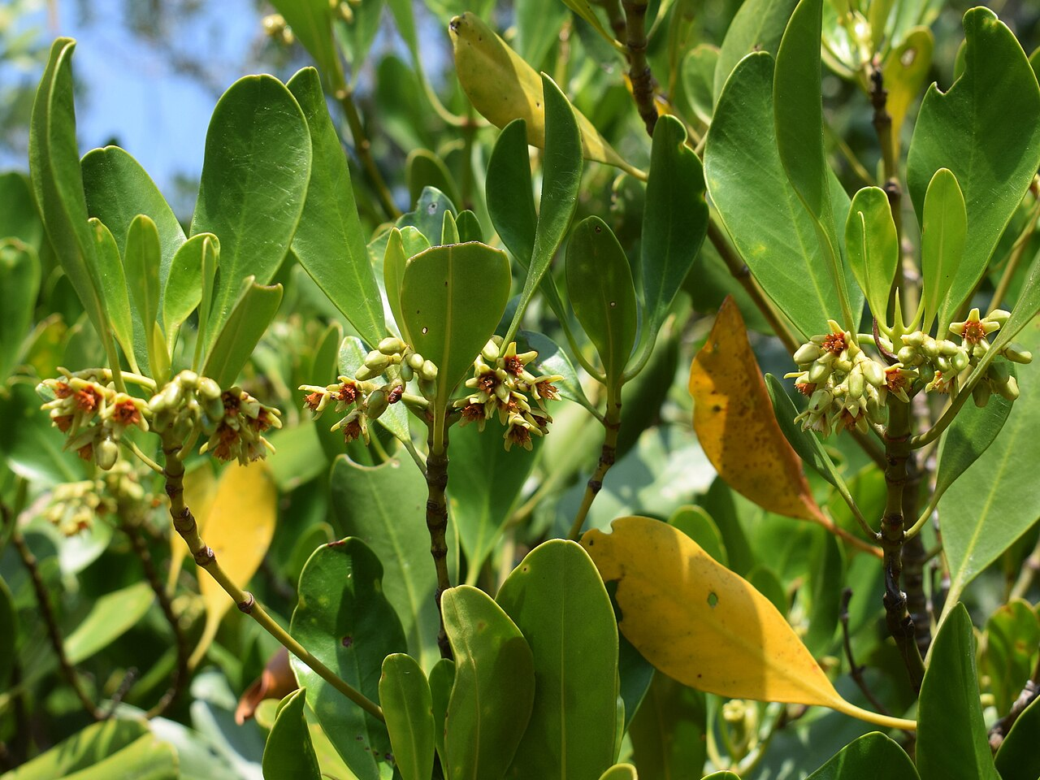
HOOK · 5 MIN
Why is this forest gold?
Thung Prong Thong, Pak Nam Prasae (about 90 minutes away)
These trees are the same species as the tall green ones a hundred metres away. Same species. Same rain. Same sun.
So why are these short and gold?
A It is autumn.
B They are a different kind of tree.
C Something in the ground is different.
Ceriops tagal — the "prong" mangrove. Photo: Abu Hamas, CC BY-SA 4.0
Write your letter in the margin. We’ll come back to this at the end.
Notes:
TIMING: 6:00–11:00.
CLICKS: 1 = the three options appear together. Do NOT reveal the answer — that is slide 14.
SAY: "Hands up for A. For B. For C. Write your letter in the margin of your book, and put a box round it. If you change your mind by the end of the lesson, that is science working."
A is a deliberate trap and a useful cultural point: there is no autumn in Rayong, so nothing here drops its leaves on a calendar. Say that out loud — it lands well with EAL students who learnt "leaves go yellow in autumn" from a British textbook.
B is the one most will pick. It is wrong and it is the more interesting wrong answer: the species is identical.
DO NOT say "nitrogen" yet. If a student says it, say "hold that thought, write it down, you may be about to be right."
STRETCH: "What would you measure to test option C?"

Slide 6
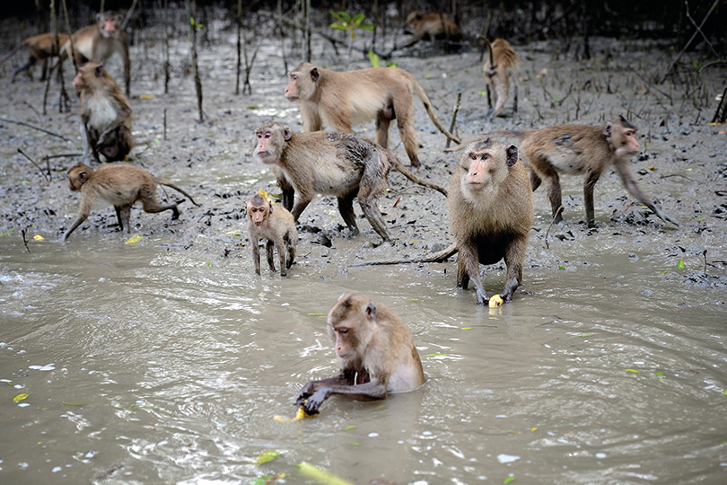
I DO · 4 MIN
ecosystem · habitat
An ecosystem has two halves
All the living things (biotic factors)
trees, crabs, fish, birds, bacteria
+ all the non-living things (abiotic factors)
water, salt, mud, sunlight, temperature
in one area
the Prasae estuary, a rock pool, a rice paddy
all interacting
Long-tailed macaques in the Khlong Khone mangrove, Samut Songkhram.
Photo: Niwat Tantayanusorn, CC BY-SA 4.0
each one changes the others
A habitat is where ONE species lives. An ecosystem includes the habitats of MANY species.
Copy the definition into your book.
Notes:
TIMING: 11:00–15:00 (first half of the 8-minute I Do; slides 6–8 share it).
CLICKS: 1 = "all the living things". 2 = "+ non-living". 3 = "+ in one area". 4 = "+ all interacting". 5 = the habitat line, bottom right.
SAY on click 2: "This is the half people forget. Write it bigger than the first one."
SAY on click 4: "Interacting is the word that makes it an ecosystem and not just a list."
WATCH FOR: "an ecosystem is the plants and animals in a place." That is misconception 1. Ask: "Take the salt water out of the mangrove. What is left?" Answer: nothing — the trees die within weeks.
EAL: ecosystem / habitat / community sound interchangeable. The bottom-right line is the whole distinction. Have them say it back to a partner before you click on.
STRETCH: "Name an ecosystem in this school." Accept the pond, the field, the compost bin.

Slide 7
I DO · 4 MIN
species · population · community
Zoom out: from one animal to the whole system
Start with one organism.
Everything else in ecology is built by zooming out from here.
SPECIES
one silver-lined
mudskipper
Notes:
TIMING: 15:00–16:30.
MAGIC MOVE: Keynote cannot import it, so this is built as two slides. In Keynote, select this slide, Animate → Transitions → Magic Move, then "Change Text Transition: Dissolve". Takes about ten seconds and it is worth it — the circle shrinking into the centre does the teaching for you.
If you skip the Magic Move, set the transition to Dissolve. It still works, just less prettily.
SAY: "One mudskipper. One species. Watch what happens when I zoom out."
No clicks on this slide. Advance straight on.

Slide 8
I DO · 4 MIN
species · population · community
Zoom out: from one animal to the whole system
ECOSYSTEM
SPECIES
one kind of organism that can breed together
COMMUNITY
POPULATION
POPULATION
all the organisms of a particular species
COMMUNITY
SPECIES
many populations together — trees, crabs, birds, bacteria
ECOSYSTEM
the community plus the non-living environment
Notes:
TIMING: 16:30–19:00.
CLICKS: after the Magic Move lands, 1 = species definition, 2 = population, 3 = community, 4 = ecosystem. One per click, left column.
SAY on click 4: "Notice the only ring that adds something non-living is the outer one. That is the whole idea of the lesson."
WATCH FOR: "population" used to mean people only. It means all the individuals of ONE species. Say "a population of mudskippers, a population of mangrove trees" twice.
EAL: get them to draw the four rings in their books and label them. Drawing beats copying here.
STRETCH: "Is the whole Gulf of Thailand one ecosystem or many? Defend your answer." There is no clean answer — the boundary is chosen by the scientist. That is a genuinely good Y9 discussion.

Slide 9
I DO · 3 MIN
abiotic factor · nutrient
Abiotic factors = parts that were never alive
Sunlight
for photosynthesis
Salt in the water
mangroves must pump salt out
Tides and water level
sets how many hours a day the roots are underwater
Oxygen in the mud
almost none, so roots grow upwards into the air to breathe
Nitrogen in the soil
mangrove forest
needed to build chlorophyll and protein — remember this one
Abiotic = "not living" — and it means NEVER living, not "dead".
Notes:
TIMING: 19:00–22:00.
CLICKS: the cross-section is already there. 1 = sunlight, 2 = salt, 3 = tides, 4 = oxygen in the mud, 5 = nitrogen (gold border — leave it up).
SAY on click 5: "Underline this one. It is the answer to the gold forest and you do not know it yet."
WATCH FOR (misconception 2): "abiotic means dead". Hold up a fallen leaf if you have one, or point at the mud: "This leaf is dead. Is it abiotic?" No — it was alive, so it is biotic. Abiotic means never alive. This single distinction is worth a minute.
EAL: bio = life, a- = not. Write "a-biotic = not-life" on the board. Same a- as in asymmetric, atypical.
STRETCH: "Which of these five would change fastest if a factory released warm water into the estuary?" Temperature, then oxygen — warm water holds less dissolved oxygen. Good bridge to Unit 5.

Slide 10
WE DO · 4 MIN
biotic factor
Your turn: abiotic or biotic?
Thumb up for BIOTIC, thumb down for ABIOTIC.
Sunlight on the canopy
A silver-lined mudskipper
A dead mangrove leaf
ABIOTIC
BIOTIC
BIOTIC — it was alive
Salt dissolved in the water
Bacteria in the mud
Rainfall in July
ABIOTIC
BIOTIC
ABIOTIC
Notes:
TIMING: 22:00–26:00.
CLICKS: six, one answer per click. Vote FIRST, then click. Do not let them see a single answer before the whole class has committed.
THE ONE THAT MATTERS: card 3, the dead mangrove leaf. Expect the room to split. Ask a student who said abiotic to explain, then a student who said biotic, then click.
MODEL ANSWER to say aloud: "Biotic. Biotic does not mean alive right now — it means it is part of the living world. That leaf was made by a tree out of sunlight and carbon dioxide, and a crab is about to eat it."
Card 5, bacteria: some will say abiotic because they cannot see them. Remind them of Y8 prokaryotes.
STRETCH: "Is a mudskipper's burrow biotic or abiotic?" Lovely argument — the hole is a shape in abiotic mud, but it only exists because a living thing made it. Accept either with a good justification; that is the skill.
If the class is struggling, stop here and re-teach. Do not go on to the three jobs until this is secure.

Slide 11
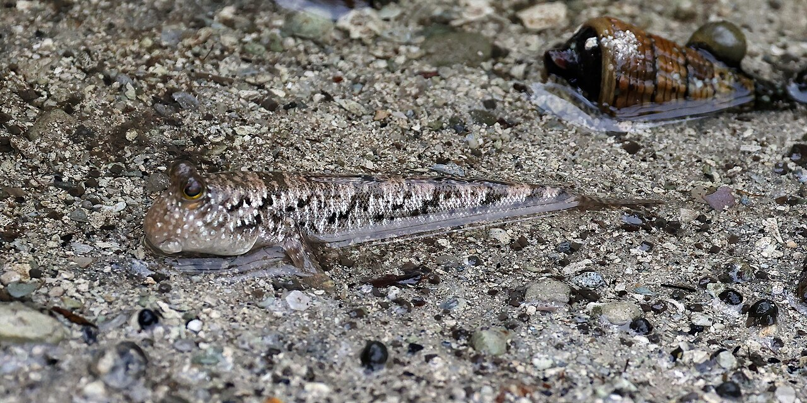
I DO · 5 MIN
producer · consumer · decomposer
Biotic factors: three jobs in the estuary
PRODUCER
CONSUMER
DECOMPOSER
makes its own food using light
eats other living things
breaks down dead material
Mangrove trees
Phytoplankton
Mudskipper. Mud crab (ปูดำ).
Oyster. Egret. Macaque.
Bacteria and fungi in the mud.
They release nutrients back.
A silver-lined mudskipper — a consumer you will meet on the boardwalk. It breathes through its skin and walks on its fins, which is why it can sit on the mud when the tide goes out.
Photo: Charles J. Sharp, CC BY-SA 4.0
Notes:
TIMING: 26:00–31:00.
CLICKS: 1 = PRODUCER card, 2 = CONSUMER card, 3 = DECOMPOSER card, 4 = the two photos and caption.
SAY on click 1: "Producer does not mean big. The most important producers in this estuary are phytoplankton you cannot see without a microscope."
SAY on click 3: "Decomposers are not a footnote. Switch off the bacteria and the mangrove buries itself in its own dead leaves in a year and the whole forest starves."
WATCH FOR (misconception 4 and 5): decomposers described as dirty, or as unimportant. And "the biggest animal matters most" — the macaque is the least important thing on this slide.
ปูดำ (pu dam) is the local mud crab. Use the Thai word — half the room fishes for them.
STRETCH: "An oyster does not chase anything. It filters phytoplankton out of the water. Producer, consumer or decomposer?" Consumer. Eating is eating, whether you chase it or filter it.

Slide 12
WE DO · 3 MIN
producer · consumer · decomposer
Check: which job does each one do?
Whiteboards. Write P, C or D. Hold them up together on three.
Phytoplankton in the river mouth
P
It makes its own food using sunlight.
A fungus growing on a fallen branch
D
It breaks down dead wood and releases nutrients.
An oyster filtering the water
C
It eats phytoplankton — filtering is still eating.
A prong mangrove tree
P
Photosynthesis, even with gold leaves.
Notes:
TIMING: 31:00–34:00.
CLICKS: eight. For each row, click one reveals the letter, click two reveals the reason. Ask for the reason from a student BEFORE you click it.
The letter is worth one mark. The reason is worth three. Say that out loud — it sets up the Gold questions on the worksheet.
WATCH FOR: the oyster. Sitting still feels like "not really eating". And the fungus — some will say producer because it is "plant-like". It has no chlorophyll.
MODEL ANSWER for row 4, said aloud: "Producer. The gold leaves still have some chlorophyll — just not enough. That is why the tree is short, not dead."
STRETCH: "Name something that is a consumer AND effectively a decomposer." A crab eating rotting leaves. Detritivore. Do not labour the term in Y9 unless they ask.

Slide 13
YOU DO · 12 MIN
On your own — worksheet, Section A to C
Start where you like. Move up when a question stops being hard.
BRONZE
SILVER
GOLD
Fluency
Mixed practice
Reasoning
Label, match and define. Get the vocabulary solid.
Sort factors, apply them to a new ecosystem.
Explain, predict and justify. Full sentences.
Stuck, or finished early? Use Gemini properly.
The three prompts are on the last page of your worksheet — copy and paste them. They ask Gemini to quiz you, to check your reasoning, and to give feedback on your Gold answer. None of them asks it to write your answer, because that would teach you nothing and I would spot it in about four seconds. Check everything it says against your own notes.
RAG grid, front page — fill in the "end of lesson" column before you pack away.
Notes:
TIMING: 34:00–46:00. Twelve minutes. This is the longest single block — protect it.
CLICKS: 1 = Bronze, 2 = Silver, 3 = Gold, 4 = the Gemini box.
SAY: "Start where you like. If three questions in a row are easy, you are in the wrong tier — move up. Bronze is not the low set, it is the warm-up."
CIRCULATE. The one thing to check in books is whether the definition of ecosystem includes the non-living half. If it does not, that student has not met objective 1 whatever else they have written.
EAL: the key-word sheet should be out on the desk for this whole block. Point at it rather than translating.
The Gemini prompts are deliberately on paper and not on the board — it keeps the projector free and it stops the whole class typing the same thing at the same moment.
At 44:00 stop them wherever they are. Gold is not homework unless you say so.

Slide 14
REVEAL · 2 MIN
abiotic factor · nutrient
So — why is the forest gold?
The answer was option C: something in the ground is different.
1
Tung Prong Thong sits on a sandbank, not deep estuary mud.
WHO SAYS SO
The tide reaches it, but it is sandy and low in nutrients.
Assoc. Prof. Dr Kitichate Sridith, a plant scientist at Prince of Songkla University, explained in 2023 that the prong trees at Tung Prong Thong are stunted and yellow because the sandbank leaves them short of nitrogen. Plant-science textbooks agree: nitrogen shortage blocks chlorophyll production, so leaves go pale and growth slows.
Same species. Same sun. Different ground.
2
Sandy ground holds very little nitrogen.
Nitrogen is an abiotic factor. It is a nutrient in the soil.
3
Without enough nitrogen, a plant cannot build enough chlorophyll.
Chlorophyll is the green pigment. Less chlorophyll, less green.
4
So the leaves stay gold and the trees stay short.
One abiotic factor, and you can see the result from a hundred metres away.
Notes:
TIMING: 46:00–48:00.
CLICKS: 1, 2, 3, 4 reveal the steps in order. 5 reveals the source panel.
SAY first: "Hands up who wrote C at the start. Hands up who has changed their mind. Changing your mind because of evidence is the whole job."
THE POINT, say it in these words: "An abiotic factor — something that was never alive — decided the colour of an entire forest. That is why we do not study the living half on its own."
WATCH FOR: "so the trees are unhealthy / dying". Not quite. They are stressed and stunted but alive and reproducing. Stunted is not the same as dying — worth a sentence.
STRETCH: "If you added fertiliser to the sandbank, what would happen to the gold?" It would green up and the tourism would collapse. Genuinely happened as a debate locally — a nice link to Unit 4.

Slide 15
CONTEXT · 1 MIN
One man, one estuary, thirty years
Chalome Wongthim · Pak Nam Prasae, Klaeng District, Rayong
Before 1994
1994
2000
Today
The mangrove is down to stumps. Charcoal burning, firewood cutting and shrimp ponds have taken most of it. Crabs, shellfish and fish are getting hard to find.
Chalome — himself a former woodcutter — finds that seedlings pushed into the mud sprout green leaves in about a month. He starts planting, alone.
Now community leader, he persuades the village to build a boardwalk. He and more than 35 villagers replant the public land at Tung Prong Thong.
He estimates the forest has gone from about 30% remaining to 70–80%. The boardwalk brings visitors, and the visitors give the village a reason to keep it.
Biotic and abiotic together: replanting put the trees back (biotic), and the trees trapped sediment and shaded the mud (abiotic), which is what let the crabs return.
Source: Sarakadee Magazine, August 2023, interviews recorded 17 June 2023.
Notes:
TIMING: 48:00–49:00. One minute. If you are short of time, cut this slide and not the plenary.
CLICKS: 1 = 1994 stumps, 2 = 1994 seedlings, 3 = 2000, 4 = today, 5 = the bottom line.
SENSITIVE — read before you teach it: Chalome cut the forest down to pay for his three children to finish school. Some of your students have family in fishing, charcoal or shrimp farming. Do NOT let this become a slide about bad villagers. His own framing is the useful one: he asked what his grandchildren would inherit, and changed. Say it as a repair story.
SAY: "He is about 80 now. He spent the first half of his life cutting it down and the second half putting it back."
THE SCIENCE POINT is the bottom line — put trees back and you change the abiotic conditions too. Do not skip it for the story.
STRETCH: "The forest is at 70–80% of what it was. Why might the last 20% be the hardest?" Shrimp ponds have hard walls and changed the water flow; the abiotic conditions no longer suit mangroves.

Slide 16
PLENARY · 5 MIN
True or false?
Stand up for TRUE. Stay sitting for FALSE. No fence-sitting.
1. An ecosystem is only the living things in an area.
FALSE Living things PLUS the non-living surroundings.
2. A dead mangrove leaf is an abiotic factor.
FALSE It was alive, so it is biotic. Abiotic means never alive.
3. Salt in the water is an abiotic factor at Prasae.
TRUE Never alive, and it decides which plants can survive.
4. "Habitat" and "ecosystem" mean the same thing.
FALSE A habitat is where one species lives.
5. Decomposers are the least important part of an ecosystem.
FALSE They release the nutrients everything else depends on.
Notes:
TIMING: 49:00–50:00 if you are running to time, or take the last 3 minutes properly and cut slide 15.
CLICKS: ten. Statement, then answer, one at a time. Make them commit physically before each answer appears — standing up is harder to fake than a hand.
Every FALSE statement here is one of the misconceptions from the hidden teacher slide. If more than a third of the class gets one wrong, that is your starter next lesson, not a footnote.
Number 2 is the one that matters most. If they get 2 right, objective 2 is secure.
EXIT: RAG grid on the front of the worksheet, "end of lesson" column, then pack away.
STOP HERE. Energy flow (your objective 4) and matter movement (objective 5) are Lesson 2 and Lesson 3. Do not start food chains with four minutes left — you will teach the arrows backwards and spend next lesson unteaching it.

Slide 17
Credits and sources
IMAGES — all Creative Commons or public domain
Ceriops tagal (prong mangrove)
Abu Hamas · CC BY-SA 4.0 · Wikimedia Commons
Long-tailed macaques, Khlong Khone mangrove
Niwat Tantayanusorn · CC BY-SA 4.0 · Wikimedia Commons
Silver-lined mudskipper, Periophthalmus argentilineatus
Charles J. Sharp · CC BY-SA 4.0 · Wikimedia Commons
SOURCES
Chalome Wongthim and the Prasae restoration; nitrogen and the gold leaves
Sarakadee Magazine, "People and the Forest", 9 Aug 2023 (interviews 16–17 June 2023)
Nitrogen shortage limits chlorophyll synthesis
Penn State Dept. of Plant Science, Nutritional Disorders; Zhang et al., J. Exp. Bot. 2022
Objectives and vocabulary
CK-12 Lesson 19.1; GIS KS3 SoW, Y9 Term 1.1 Unit 2
Notes:
Not shown in the lesson unless someone asks. Kept in the file so the licences travel with the deck if you share it.

